Slide 1
A1: DIGITAL 101
The impact of digital on journalism

Slide 2
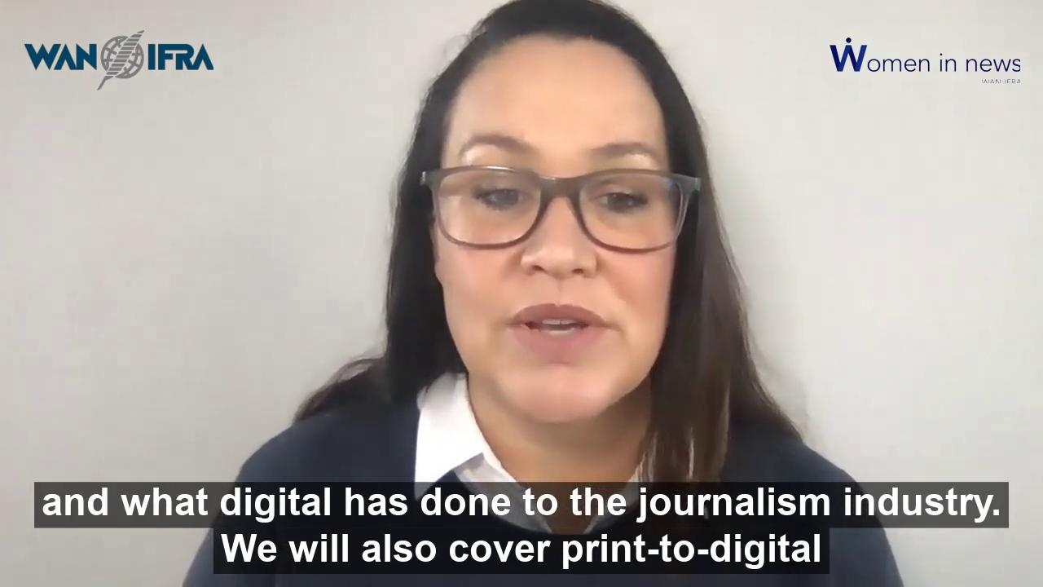
Introduction: Video and Audio
For a multimedia introduction to this session, please click on the “play” button on the left or on the audio file below.

Slide 3
Table of Contents
Section 1: Is digital journalism still journalism?
Changes in consumption patterns
Impact on revenues and business models
World Press Trends
STOP AND THINK: What has changed in your newsroom?
Section 2: The changing landscape
Print to digital convergence
Impact on journalism: what’s changed
Why embracing change is essential
STOP AND THINK: What is the future of journalism?
GROUP WORK: An exercise on what the future of journalism and media will look like
TIME FOR REFLECTION: What does this mean for your newsroom?

Slide 4
Section 1
Notes:
In Section 1 of this first session we will be asking the very important question: Is Digital Journalism still Journalism?
We will look at the disruptors in media, and in the news industry in particular - and examine a quick snapshot of media consumption worldwide.
You will then find a separate video in which I talk you through some slides about the time spent on different platforms.

Slide 5
IS ‘DIGITAL JOURNALISM’ STILL JOURNALISM?

Slide 6
Yes! Digital journalism is still journalism: just the medium has changed
Digital in the context of a news business really means “the act of producing journalism for an online audience”.
Newsrooms are traditionally print focused, so the move to online has caused massive disruptions to the industry, and to newsrooms all over the world
The challenge for news organisations has been to understand that readers have evolved and now often prefer the consumption of their news on digital devices, and to meet their needs sufficiently
Data is a critical component of the new digital ecosystem: not only to give readers a better experience, but also to service advertising clients
Our readers are no longer reliant on the daily delivery of news in the form of a newspaper: they can get the news anytime and anywhere.
Our competition is no longer just other newspapers: it is social media, bloggers, start-ups, newsletters etc
We had the monopoly on readers’ attention for a long time: how do we get it back?

Slide 7
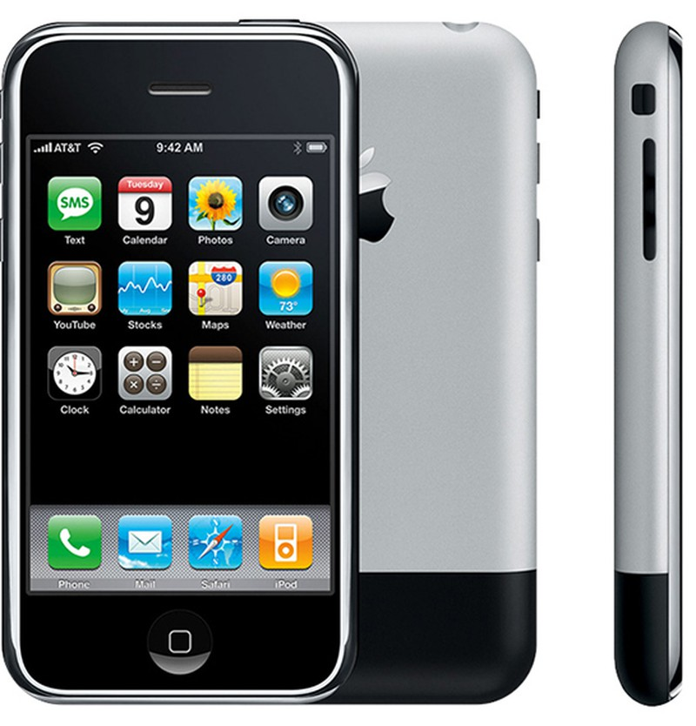
A thought:
The launch of the iPhone in 2007 may have been the biggest disruptor to our industry in centuries!

Slide 8
Global trends in media consumption (2014-2018)
Digital news consumption is increasing
Digital consumers are now spending 6 ¾ hours per day online, with 3:18 hours of this time – 51% - spent online via mobiles (up from 1 hour 17 mins in 2014)
This includes online TV
Online TV has exceeded an hour per day, but linear TV is holding steady at just under 2 hours
News consumption via social media leads
2:20 hours a day go on social media, account for the biggest share of online media time (35%)
Most people are doubling up
With over 85% second-screening as they watch TV, simultaneous multi-media consumption is now the norm. Mobiles are the clear device of choice here

Slide 9
There have been big disruptors in many industries...
Cable TV changed terrestrial TV watching, then Netflix and other streaming services disrupted cable
In the music industry, compact discs destroyed the cassette tape market, and then Spotify and other streaming services disrupted CDs and now radio
Who even remembers Betamax, VHS and Blu-Ray discs?
The e-reader or Kindle disrupted the book industry, and then smartphones disrupted Kindles

Slide 10
… And huge changes in the news industry
Changes in consumption patterns:
Newspapers and magazines have been disrupted on countless fronts: firstly by the move to desktop computers, although the effect of the desktop was more pronounced in mature markets
Smartphones, apps and ubiquitous internet connections have been the true disruptors
Digital distribution has eroded both the advertising market upon which news has been dependent for so long, and for a long time - and catastrophically - the subscription market
Social media platforms have democratised the distribution of news and created more competition for the attention of readers and consumers

Slide 11
Listen and learn: Daily media time

Slide 12
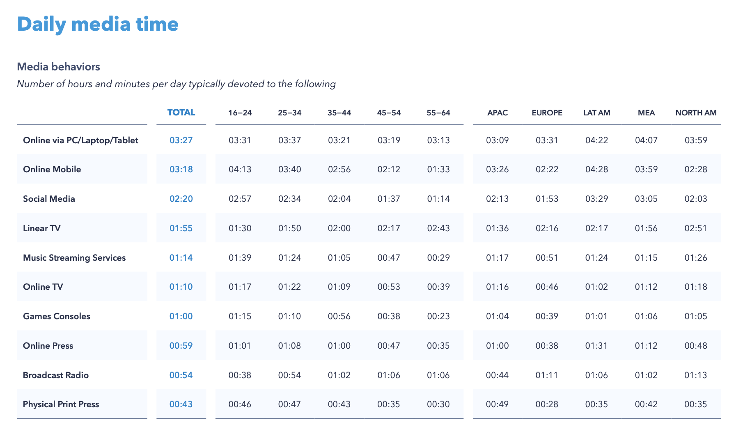
There is a lot of competition for our time
Middle East and Africa
Global Web Index 2018: 320k users surveyed
Notes:
Note that about 42 minutes a day are devoted to print with 1 hour 12 minutes devoted to online news

Slide 13
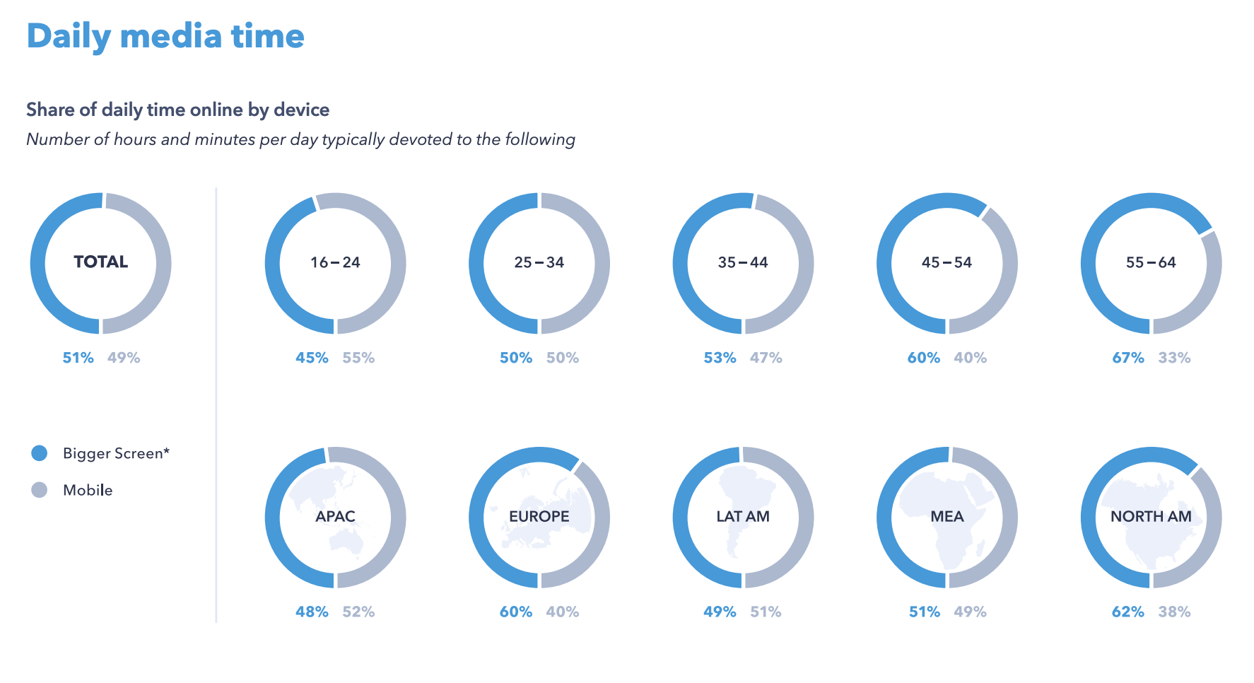
This shows the high importance of mobile
Notes:
The Middle East and Africa region and Latam are similar in profile.

Slide 14
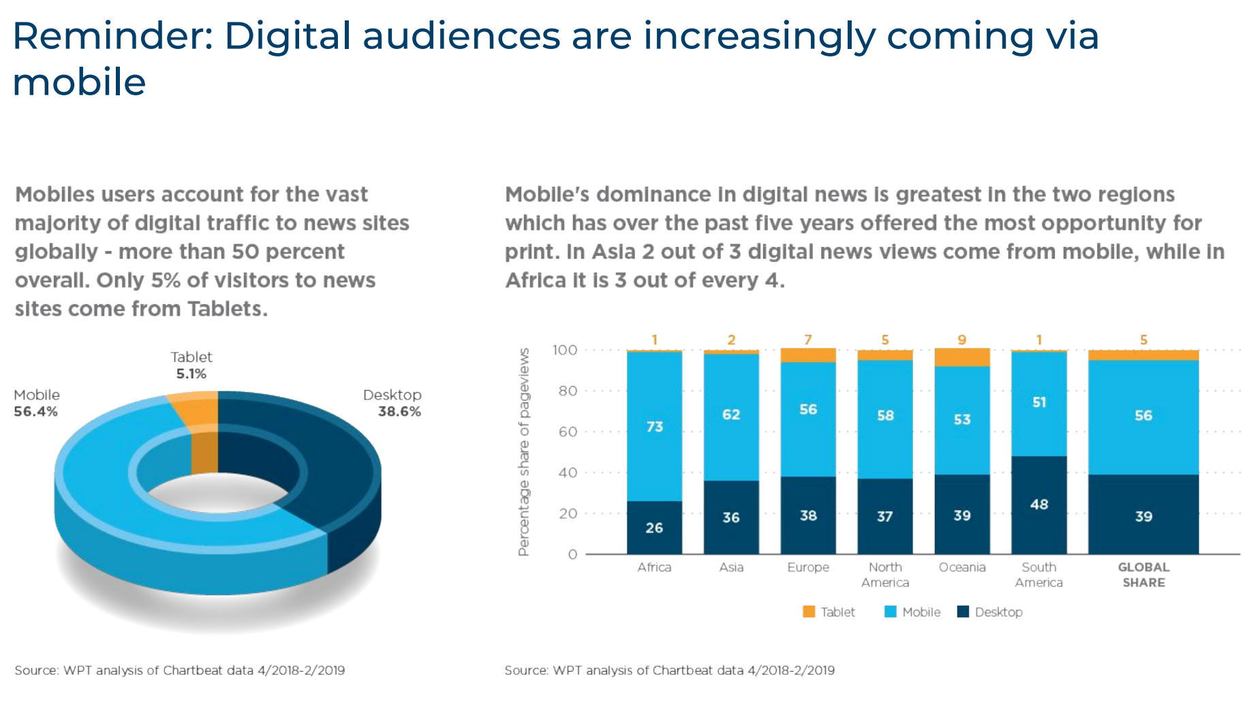
World Press Trends: move to mobile
Mobile penetration in Africa!
Notes:
Note that about 42 minutes a day are devoted to print with 1 hour 12 minutes devoted to online news

Slide 15
STOP & THINK
Let’s stop for a moment:
How many hours a day do you spend on different kinds of media compared to Slide 13?
How ubiquitous is mobile in your region?
Is your organisation geared to serve your audiences on mobile?

Slide 16
Section 2

Slide 17
IMPACT OF DIGITAL ON JOURNALISM
Notes:
In this section, we will be focusing on the the impact of digital on revenues and business models - how the combination of declining advertising revenues and circulation, coupled with low digital income equates to a perfect storm for publishers
Walk through some revenue scenario graphics from the world press trends report
And then we will also look at what this means for newsrooms and there will be a Discussion Break for this topic: what changes have you seen in your own newsroom - work practices, planning, forward planning, publishing schedules, skills?

Slide 18
Impact on revenues and business models
The move to digital consumption and the decline of print has changed media forever
The main change has been the decline in circulation revenue for print, and in turn the decline in advertising revenue as advertisers don’t want to pay for dwindling reach
Costs remain high to print and distribute newspapers, but print revenue is declining and digital revenue is still lagging significantly behind print

Slide 19
Impact on revenues and business models
One of the reasons digital revenue is lower than it should be is that there has been an incredibly slow response from the industry to charge for news online
As such consumers do not believe they need to or should pay and claim they can simply find other free sources of news - competitors or social media
Too much reliance on digital ad revenue is problematic
The result is a perfect storm of declining revenues on all fronts for publishers

Slide 20
Listen and Learn: World Press Trends

Slide 21
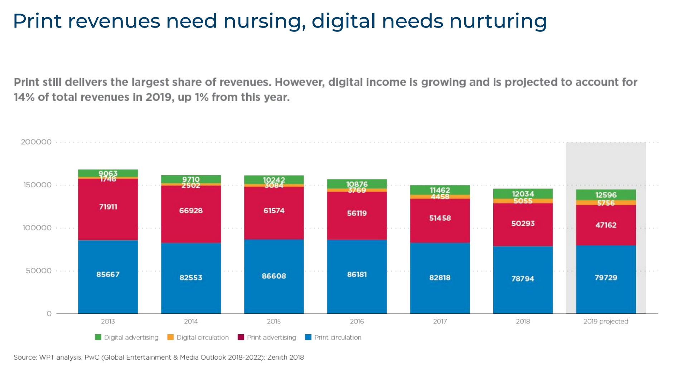
World Press Trends: Print vs digital revenue
Notes:
Note that about 42 minutes a day are devoted to print with 1 hour 12 minutes devoted to online news

Slide 22
World Press Trends: ad spend breakdown
Notes:
Note that about 42 minutes a day are devoted to print with 1 hour 12 minutes devoted to online news

Slide 23
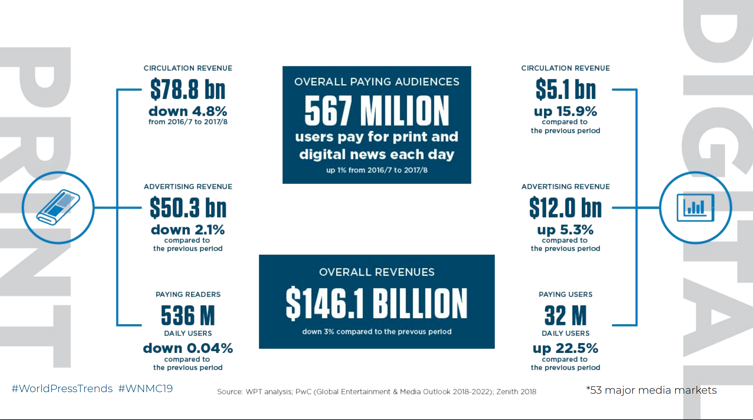
World Press Trends: print leading revenues
Notes:
Note that about 42 minutes a day are devoted to print with 1 hour 12 minutes devoted to online news

Slide 24
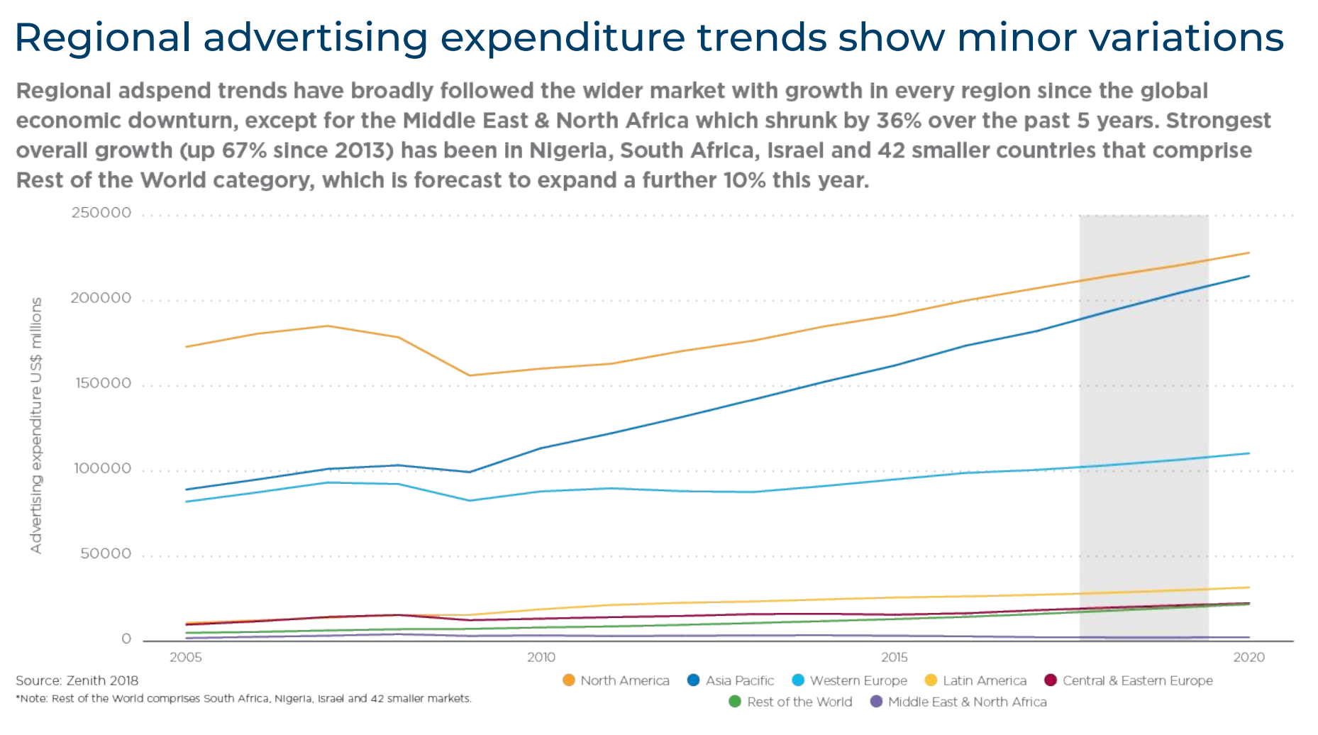
Growth is stronger in developing markets
Nigeria, South Africa, rest of world category: up 67%!
Mid East, North Africa down 36% in 5 years

Slide 25
Print to digital convergence: what it means
Most media companies are in some form of transition: for many print is still the driving force, for others digital is the kingpin
This depends on what stage in the evolution the company is: does print have the greater “gravitational pull” on the newsroom - and on management because of greater revenues?
Or has management decided that digital (despite low revenue) needs to be front and centre of strategy - rather than on the edge of your universe - in order to future-proof the business?
“Convergence” in this sense is the reprioritisation and rebalancing of traditional business models to meet the new challenges of a digital world (See this quote to make the point!)
PRINT?
DIGITAL?
NEWSROOM

Slide 26
A reminder…
Insanity is doing the same thing over and over again, and expecting different results.
- ALBERT EINSTEIN
(Fake News alert: nobody knows who said it…)
“
“

Slide 27
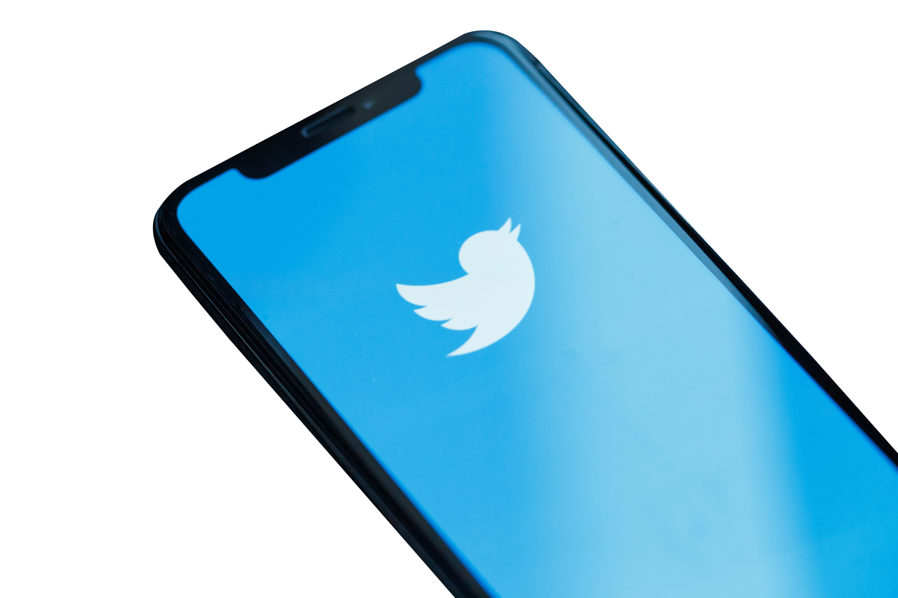
Impact on journalism: what has changed
Some of the changes to be expected in newsrooms: firstly it would be likely that there has been a dramatic evolution of workflows in the past 10 years
Journalists are filing for print and online (hopefully online first?): but also Tweeting, making multimedia videos and podcasts
It is likely that journalists, news editors and production editors are all significantly more multi-skilled and able to work across platforms than in the past

Slide 28
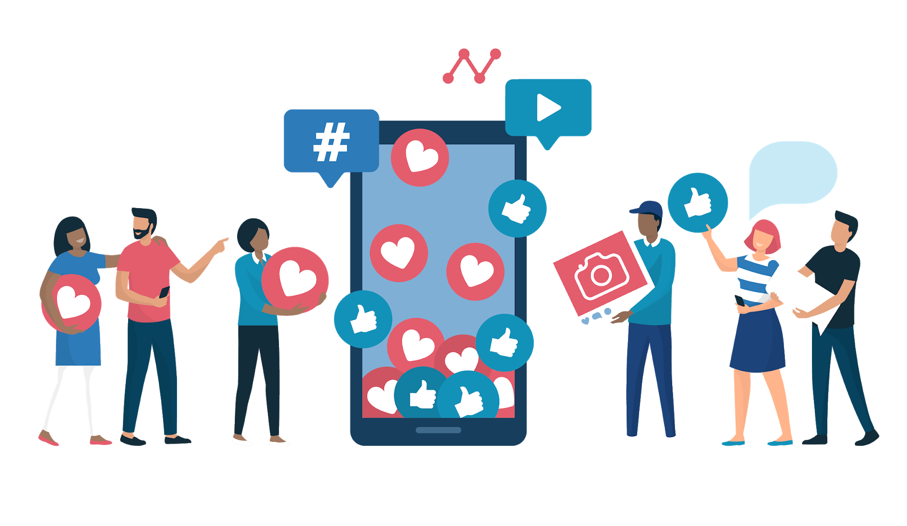
Impact on journalism: what has changed
News deadlines are no longer based on print output, but rather based on digital publishing schedules: it is faster, and the processes are streamlined
Articles are published once every 24 minutes rather than once every 24 hours!
Smartphones mean reporters can access, write, record and send news continuously if needed
Websites are no longer uploading news stories AFTER the paper has been printed, but rather as news breaks, to meet reader demand

Slide 29
STOP & THINK
We have covered a lot of information, so let’s stop and think for a moment:
What does this all means for newsrooms: what changes have you seen in your own newsroom - work practices, planning, forward planning, publishing schedules, skills?
Have a look at slide 27 on newsroom impact, and discuss with your colleagues how much of the changes described apply to your own newsroom

Slide 30
Section 3

Slide 31
THE CHANGING MEDIA LANDSCAPE

Slide 32
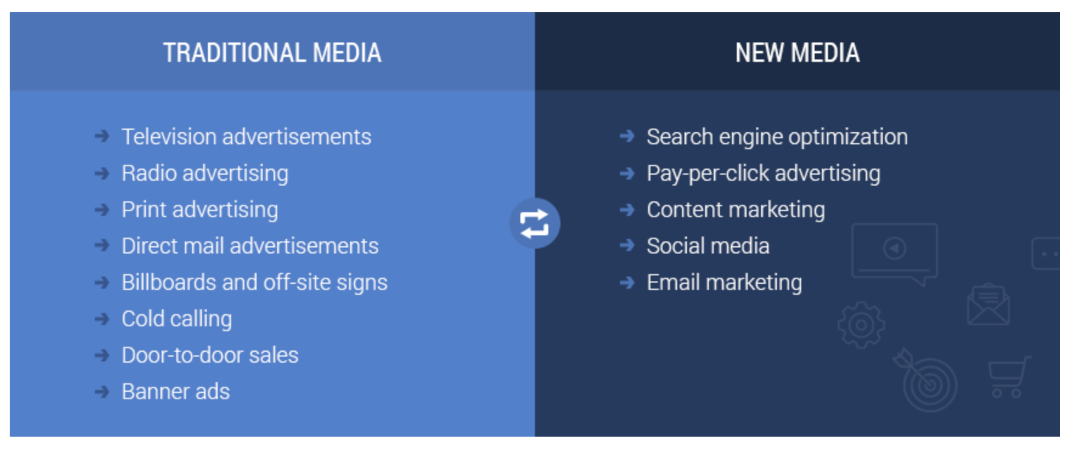
Differences between traditional and “new” media methods
Notes:
Note that about 42 minutes a day are devoted to print with 1 hour 12 minutes devoted to online news

Slide 33
Why change is essential: how to embrace it
News organisations are under deep pressure: the COVID-19 crisis of 2019/20 has exacerbated that pressure enormously.
The solution is not to stand still and hope for the best at a time like this
Most of the companies that have weathered the storm of the past decade have been dedicated to change and development: of business models, working practices, skills and distribution models
Those that have not are genuinely facing a challenge for survival as print is in terminal freefall

Slide 34
Why change is essential: how to embrace it
The speed of digital change is fast and relentless, and will not stop to wait for anyone
A good example of this is the use of robo-journalism to improve efficiency: See here
Enthusiasm for change and for doing things differently has to come from the very top of an organisation, and filter through to all the staff
It is hard to make changes, but the rewards - longevity, job preservation, the craft of journalism continuing into the future - are well worth it

Slide 35
A bit of fun: Bowie looks into the future
In this video for the BBC with Jeremy Paxman in 1999, David Bowie predicts the huge impact on society that the internet will have, with remarkable prescience.
Bowie speaks about content, audience and the narrowing of the gap between the producer and consumer.
Paxman looks incredulous.
What do you think about his views?

Slide 36
WORK TOGETHER
Connect with your group members to discuss the following questions. Submit your group's answer to digitalABC@womeninnews.org
Read here to see what a group of journalism and media students think the future will look like.
Can you agree on what the future of news will look like?
How do your colleagues in your newsrooms feel about the convergence of print and digital - is there more resistance or more excitement?
How is your management team handling the changes: do you have the support you need from the top down? What more could they be doing to help?

Slide 37
INDIVIDUAL REFLECTION
Please take some time to think about the following:
Think about print and digital convergence in your own business: are you satisfied with the progress made in your company?
Have you been part of the changes or are you still an observer?
What do you think could have been done differently and what has worked so far?

Slide 38
END OF LESSON ONE

